Slide 1
Chapter 10
The Tower of Babel

Slide 2
Learning Objectives (1 of 2)
Explain why so many programming languages exist
List four key procedural languages and the main purpose for the development of each
Describe the purpose of each special-purpose language: SQL, HTML, JavaScript, and R
Describe the alternative paradigms for programming languages: functional, logic, and parallel

Slide 3
Learning Objectives (2 of 2)
Name a functional programming language and a logic programming language
Describe how logic programming languages work, and explain what facts, rules, and inference are
Explain how the MIMD model of parallel processing could be used to find the largest number in a list

Slide 4
Why Babel?
Why isn’t there just one high-level programming language?
Why isn’t there just one model of automobile?
Each language has tasks it performs well
Complex computations on real numbers
Detailed page layout
Database interactions
Choose a language based on the tasks to be done
Choose a language based on its approach to computation (its philosophy)

Slide 5
Procedural Languages (1 of 15)
Procedural language philosophy
Tell the computer step by step how to manipulate variables (data in memory locations)
Analogy to Romance languages
Here we survey procedural languages by historical perspective and intended purpose
Plankalkül, Fortran, COBOL, C/C++, Ada, Java, Python, C# and .NET

Slide 6
Procedural Languages (2 of 15)
Plankalkül
Translation: “formal planning system.”
Developed in Germany in 1945 by Konrad Zuse
Never implemented
Had the sophisticated concepts presented in the manual been known prior to 1972, they may have changed the development of programming languages

Slide 7
Procedural Languages (3 of 15)
Fortran: Formula Translating System
Developed at IBM in the 1950s by John Backus
First high-level language actually implemented
Focus on numerical computation
Control structures similar to assembly language
GO TO
Like a JUMP
Can create spaghetti code
External libraries: tested special-purpose code
So many libraries exist that coders sometimes don’t need to write actual code

Slide 8
Procedural Languages (4 of 15)
COBOL: COmmon Business-Oriented Language
Developed by the U.S. Navy in 1959 and 1960 by a group headed by Admiral Grace Murray Hopper
Focus on business applications
Inventory or payroll
Master file updated by transaction files: file I/O key
Wide use in legacy code (60% of existing code)
Year 2000 (Y2K) issues
Required massive updating of old COBOL

Slide 9
Procedural Languages (5 of 15)
C/C++
C developed in the early 1970s at AT&T Labs by Dennis Ritchie
Focuses on system programming
Close connection to UNIX
Highly efficient
High-level constructs as desired
Low-level constructs when efficiency is needed

Slide 10
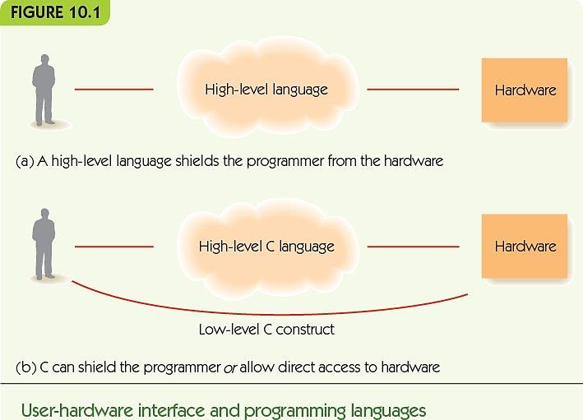
Procedural Languages (6 of 15)

Slide 11
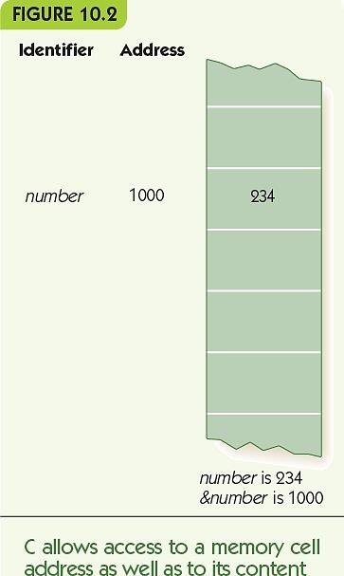
Procedural Languages (7 of 15)
Access to variable’s value and its location
number refers to its value
&number refers to its memory location
Pointer data type contains memory locations

Slide 12
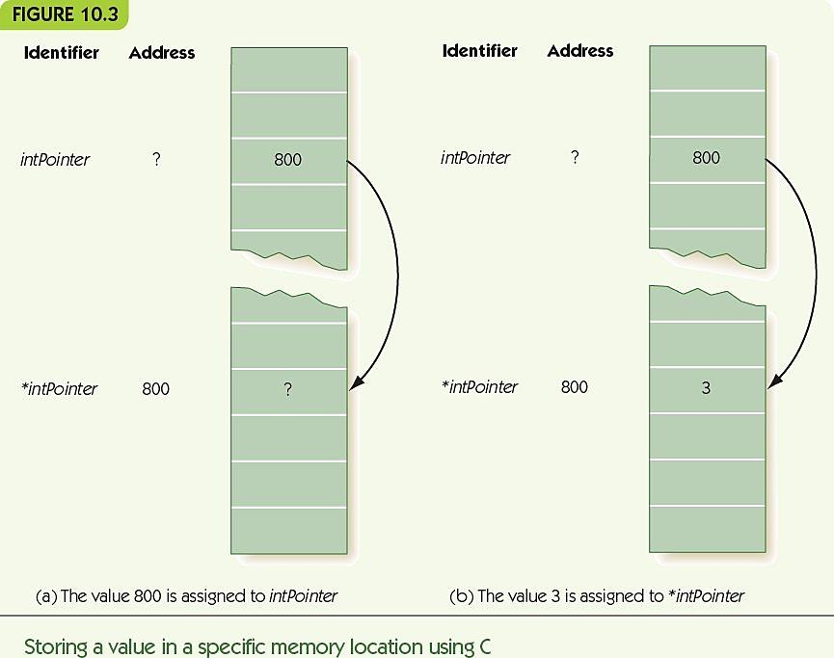
Procedural Languages (8 of 15)

Slide 13
Procedural Languages (9 of 15)
C specialty: system programming
Example: device drivers
Ability to interact with low-level hardware
C++ was developed in the early 1980s at AT&T Labs by Bjarne Stroustrup
C++ is a superset of C
Object-oriented programming
Collections of code libraries

Slide 14
Procedural Languages (10 of 15)
Ada
Developed in the 1970s by the U.S. military
Specialties
Multiprocessing
Strong object-oriented
Safety and reliability
Used heavily by
Defense Department
Transportation industry
Financial industry
Communications industry

Slide 15
Procedural Languages (11 of 15)
JAVA
Developed by Sun Microsystems Inc. in the early 1990s
Designed for
Platform independence
Reliability
Security
Graphical user interfaces
Strong integration with web browsers
Object-oriented, like C++

Slide 16
Procedural Languages (12 of 15)
Java programs may be
Applications: stand-alone programs
Applets: programs that run from webpages
Portability is a key strength
Applications and applets run on most platforms and through most browsers
Source code compiles to platform-independent bytecode (generic low-level code)
Java bytecode interpreter translates to host machine (small program, integrated into browsers)

Slide 17
Procedural Languages (13 of 15)
Python
Developed by Guido van Rossum in the early 1990s
Open source: source code for Python is freely available and anyone may suggest changes
Language evolution is now guided by the Python Software Foundation
Developed for system administrator tasks and web interfaces
Interpreted language: source code is translated to object code when executed
Relaxed syntax, easy to use, extensive libraries

Slide 18
Procedural Languages (14 of 15)
C#
Developed by Microsoft in 2000
Successor to C++ but not a superset
Similar to Java in form and goals
Security
Reliability
Integrated into the .NET framework
Microsoft support framework for many languages
Large collection of code libraries and tools
Garbage collection: reclaiming memory for reuse

Slide 19
Procedural Languages (15 of 15)
.NET
All .NET languages are compiled into Microsoft Intermediate Language (MSIL)
MSIL code is compiled by a just-in-time (JIT) compiler, small program that produces platform-specific object code
.NET languages include Ada, COBOL, C++, C#, and Visual Basic .NET

Slide 20
Special-Purpose Languages (1 of 8)
Languages designed for one specific purpose, not general-purpose programming languages
SQL, Structured Query Language
Ask questions about data in a database
HTML (HyperText Markup Language)
Describes the formatting of webpages
JavaScript
Lightweight scripting language for active webpages
Code is embedded in the HTML for the page

Slide 21
Special-Purpose Languages (2 of 8)
SQL
Developed by IBM in 1986
Databases store data
A query describes what information the user wants, not how to find it
Example: Find all names of vendors with whom we do more than $40,000 worth of business
SELECT NAME
FROM VENDOR
WHERE PURCHASE > 40000

Slide 22
Special-Purpose Languages (3 of 8)
HTML
Contains text to be displayed and tags
Tags describe
Formatting of text
Special effects
Links to other webpages
Tags come in pairs: begin and end
Tags are written within angle brackets
<title> and </title>
<em> and </em>

Slide 23
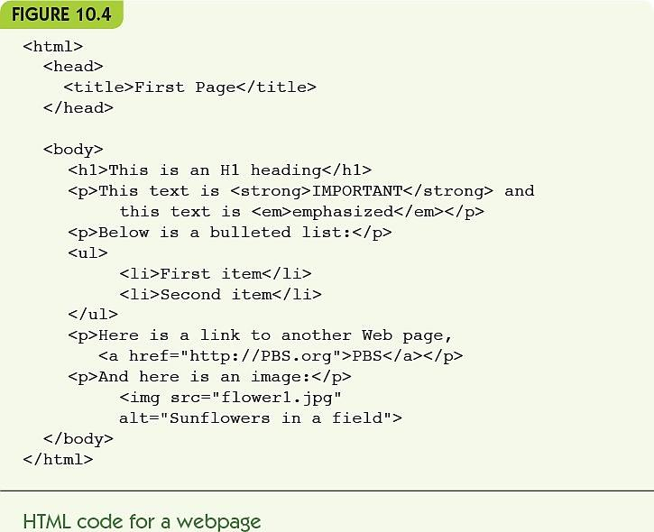
Special-Purpose Languages (4 of 8)

Slide 24
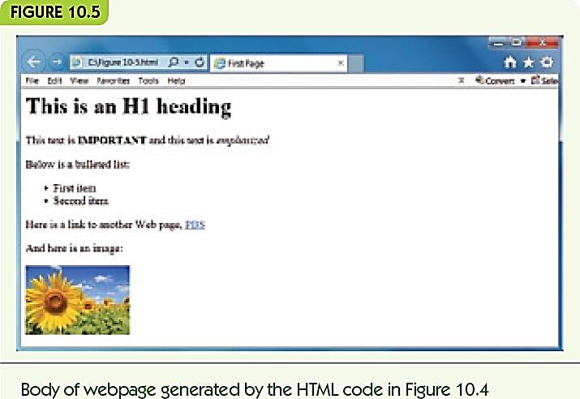
Special-Purpose Languages (5 of 8)

Slide 25
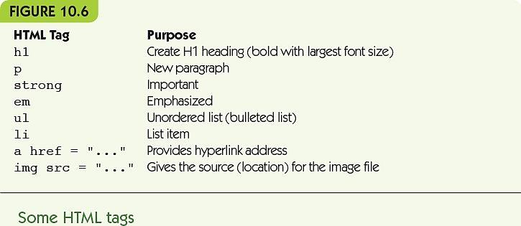
Special-Purpose Languages (6 of 8)

Slide 26
Special-Purpose Languages (7 of 8)
JavaScript
Code embeds in HTML
Enables webpages to react to users
Scripting language
Interpreted
Lightweight (reduced features)

Slide 27
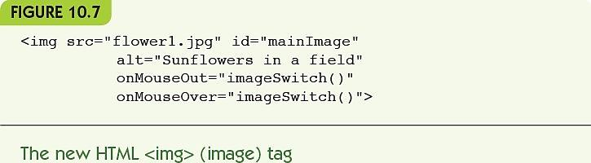
Special-Purpose Languages (8 of 8)
JavaScript example
Change image when mouse moves over it
Event handler: a function that responds to an event like mouse movement, button clicks, etc.

Slide 28
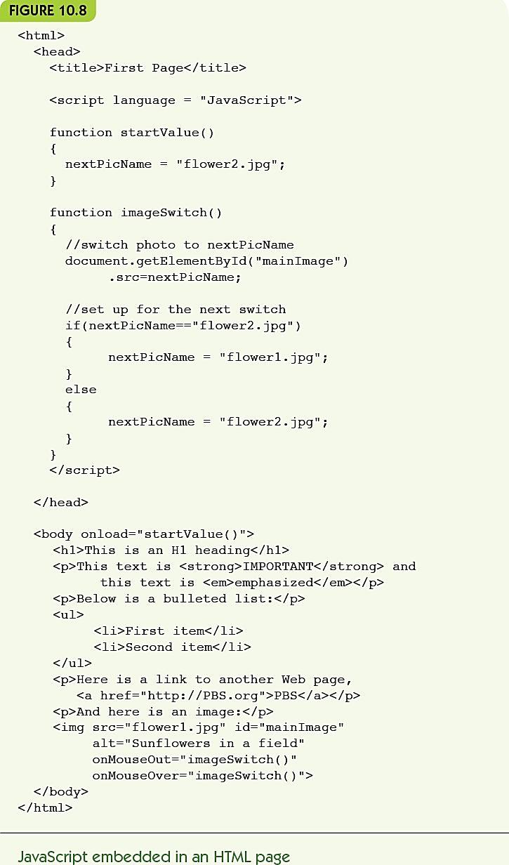
Figure 10.8 JavaScript embedded in an HTML page

Slide 29
Alternative Programming Paradigms (1 of 16)
Paradigm: model or mental framework for thinking about something
Procedural programming paradigm
A program is a sequence of detailed instructions, accessing and modifying memory locations
Functional programming paradigm
A program is a series of transformations on items

Slide 30
Alternative Programming Paradigms (2 of 16)
Logic programming paradigm
A program is a series of logical deductions from known facts
Parallel programming paradigm
A program is made up of
Multiple copies of the same subtask OR
Multiple subtasks of the same problem
Performed simultaneously by different processors

Slide 31
Alternative Programming Paradigms (3 of 16)
Functional Programming
LISP was developed in 1958 at MIT by John McCarthy
Scheme is a variant of LISP developed in the 1970s
Functional programming language
Organized around functions
A function takes inputs and produces a single value
Define functions
Call, or apply, functions
Combine function calls
Applicative languages

Slide 32
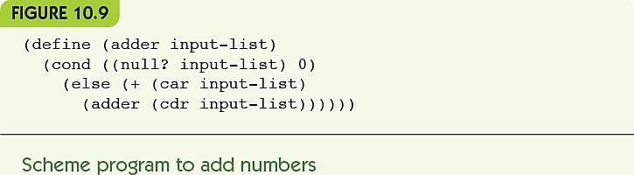
Alternative Programming Paradigms (4 of 16)
Lists: linear collections of data
(list 5 1 2) = (5 1 2)
(car (list 5 1 2)) = 5
(cdr (list 5 1 2)) = (1 2)
(null (list 5 1 2)) = false

Slide 33
Alternative Programming Paradigms (5 of 16)
Example:
(adder (5 10))
= (+ 5 (adder (10))) = 5 + (adder (10))
= 5 + (+ 10 (adder ())) = 5 + 10 + (adder ())
= 5 + 10 + 0 = 15
Recursive: defined in terms of smaller versions of itself
No side effect here: no changes to values outside calculation

Slide 34
Alternative Programming Paradigms (6 of 16)
Logic programming languages
Programs describe rules and facts, not how to do something
Queries use logical deduction to produce outputs that follow from the rules and facts given
Declarative programming languages
Programs declare what is true
Artificial intelligence applications
Expert systems solve problems with logical reasoning

Slide 35
Alternative Programming Paradigms (7 of 16)
Prolog was developed in 1972 at the University of Marseilles by A. Colmerauer
Facts describe relationships among specific objects
president(nixon, vietnam_war).
Rules describe general relationships using variables
precedes(X, Y) :- before(X, Y).
X precedes Y if X came before Y
precedes(X, Y) :- before(X, Z), precedes(Z, Y).
X precedes Y if X came before Z and Z precedes Y

Slide 36
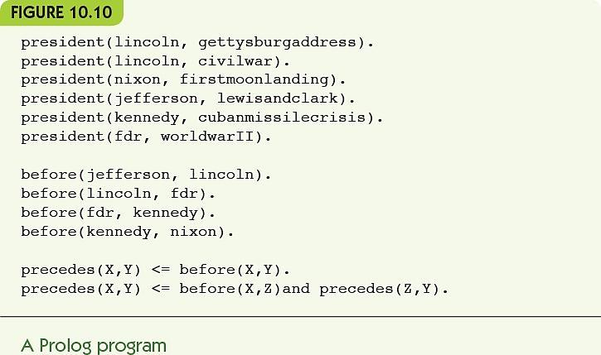
Alternative Programming Paradigms (8 of 16)

Slide 37
Alternative Programming Paradigms (9 of 16)
Programming in Prolog
Programmer builds a knowledge base of facts and rules
To “run” a program, pose queries to the inference engine, deductive algorithm is provided in Prolog
Results to the query come back from Prolog
Example of deductive reasoning using fixed rules
Modus ponens: if we know the rule “If A then B” and we know A is true, then we deduce that B is true

Slide 38
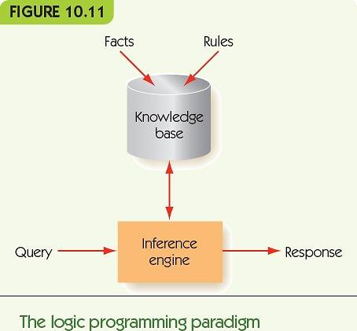
Alternative Programming Paradigms (10 of 16)

Slide 39
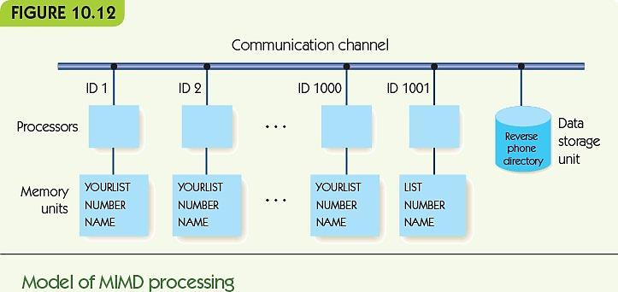
Alternative Programming Paradigms (11 of 16)
Parallel programming is required for large-scale computing problems

Slide 40
Alternative Programming Paradigms (12 of 16)
SIMD: single instruction, multiple data
Single control unit, many ALUs
Control unit sends an instruction to all ALUs at once
MIMD: multiple instruction, multiple data
Many CPUs, each operates on its own data
Multicore computing
Multiple processors on one chip
Cluster computing
Processors may be heterogeneous
Connected by a LAN or WAN

Slide 41
Alternative Programming Paradigms (13 of 16)
SIMD example: add K to each value in a vector 6 long
Six ALUs, each with unique ID from 1 to 6
Private memory versus shared memory
Each ALU has a private copy of its vector value
K : public
V : private
...
PARALLEL [1..6]
V=V+ K
END PARALLEL

Slide 42
Alternative Programming Paradigms (14 of 16)
MIMD example: search for a name in a NYC phonebook
101 processors
Processor 101 handles input/output
Divide data and tell processors what to search
Wait for result from some processor
Output result
Processors 1 to 100 search their portion of data

Slide 43
Alternative Programming Paradigms (15 of 16)
MIMD better example: find largest number in a list
Divide-and-conquer: split problem into smaller pieces and send to other processors
Top processor divides data in two, sends to two child processors
Repeat until processors have one piece of data
Children send parent their largest value
Parent compares two largest and returns the bigger to its parent

Slide 44
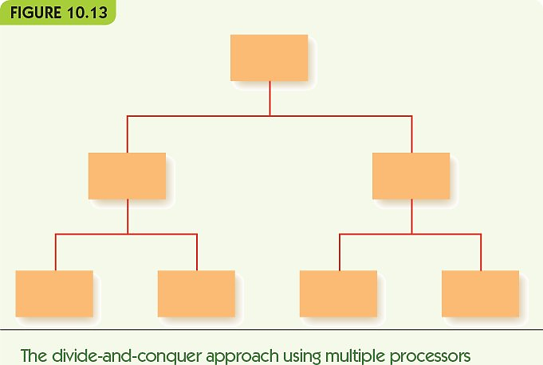
Alternative Programming Paradigms (16 of 16)

Slide 45
New Languages Keep Coming (1 of 3)
Go was developed in 2009 at Google by Ken Thompson
Combines ease of programming with safety
Supports networked and multicore computing
Fast compilation, open source
Swift: new Apple language for building apps in iOS and macOS

Slide 46
New Languages Keep Coming (2 of 3)
Milk was announced in September of 2016 by MIT’s Computer Science and Artificial Intelligence Laboratory
Geared toward “big data”
Focused on using cache memory on multicore processors to speed up the process of accessing data
Speeds up programs 3 to 4 times

Slide 47
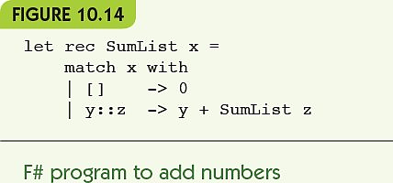
New Languages Keep Coming (3 of 3)

Slide 48
Conclusion
Languages vary by
Philosophy
Intended application areas
Strengths and purposes
Style, syntax, and semantics
Approaches to types, variables, and memory
Tools provided or accessible
Languages cross paradigms

Slide 49
Summary (1 of 2)
Many programming languages exist because they reflect different intended uses or different philosophical views.
Procedural programming languages include
Plankalkül, Fortran, COBOL, C/C++, Ada, Java, Python, and C#.
Special-purpose programming languages have limited range of use: SQL, HTML, and JavaScript.
Other paradigms include
Functional, logic, and parallel programming.

Slide 50
Summary (2 of 2)
Functional programming languages organize programs around functions, function calls, and combining of functions.
Logic programming languages do not specify how to do something but give facts and rules and let the program deduce the results.
Parallel programming languages support SIMD or MIMD parallel processing.
New programming languages evolve continuously for new or evolving purposes.

